Slide 1

Predicting Presidential General Election Outcomes at County-Level

Slide 2

Background/ Introduction

Slide 3
Problem
No universal method to accurately predict how particular counties will vote in US presidential general elections
Difficult to interpret and analyze county-level demographics and their impact in elections
Difficult to analyze changing trends in county-level demographics

Slide 4
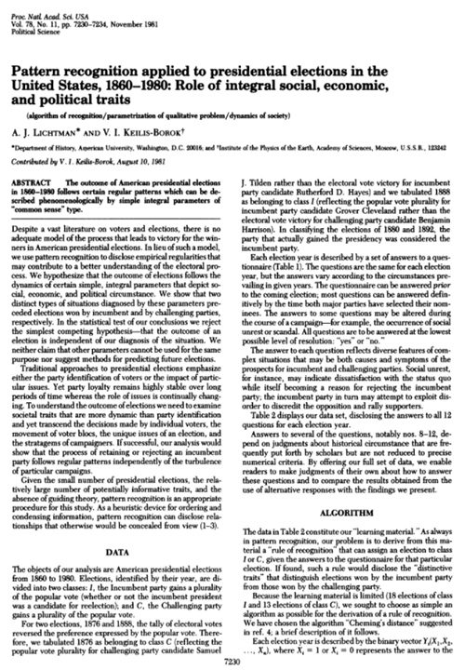
Introduction
Pattern recognition applied to presidential elections in the United States, 1860-1980: Role of integral social, economic, and political traits, Lichtman & Keilis-Borok, 1981

Slide 5
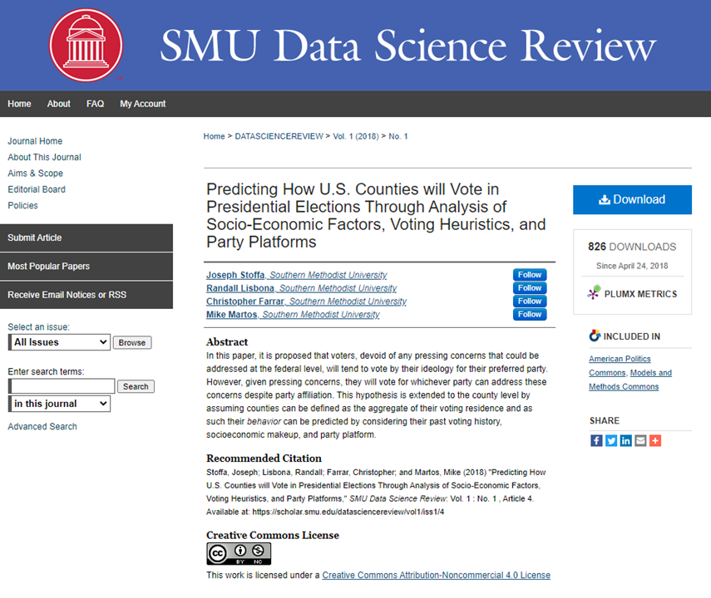
Introduction
Predicting How U.S. Counties will Vote in Presidential Elections Through Analysis of Socio-Economic Factors, Voting Heuristics, and Party Platforms, Stoffa et al, 2018

Slide 6
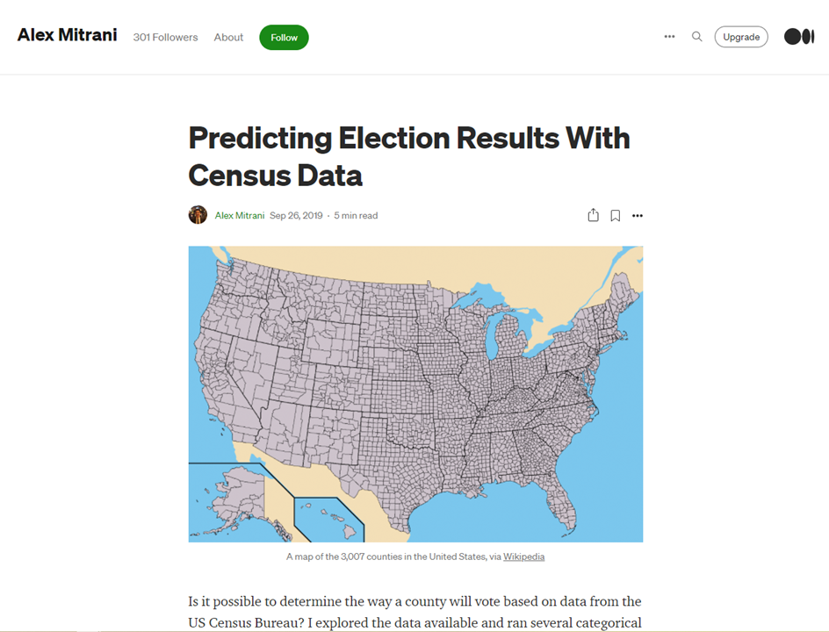
Introduction
Predicting Election Results, Mitrani, 2019

Slide 7
Proposal
Develop a regression model that accurately predicts the percentage of Trump’s vote in a county (2016 & 2020 Election)
Develop a classification model that accurately predicts the candidate who wins majority vote in a county (2016 & 2020 election)
Gain insights into which predictors changed and how over the course of the two election cycles.

Slide 8
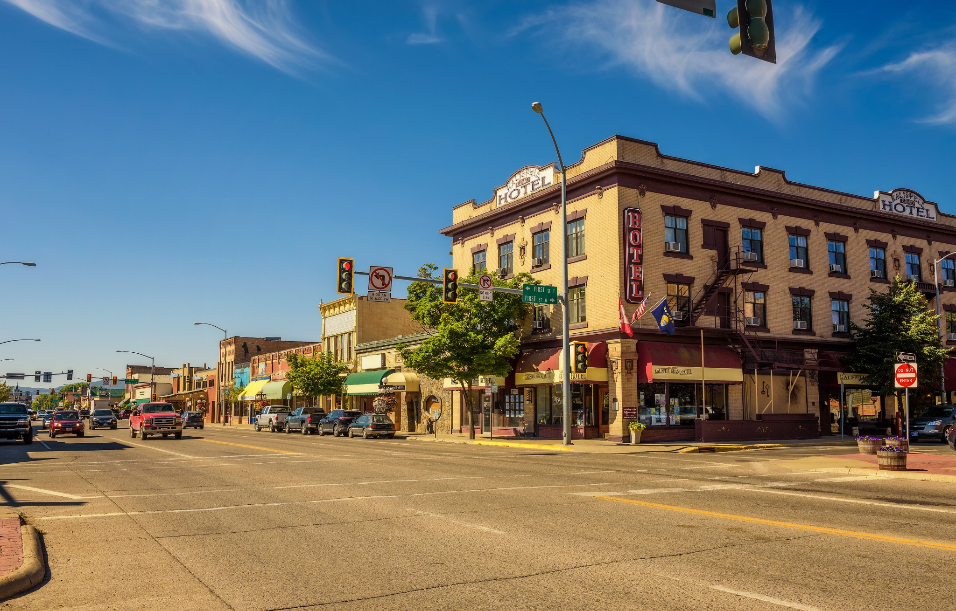
Methodology

Slide 9
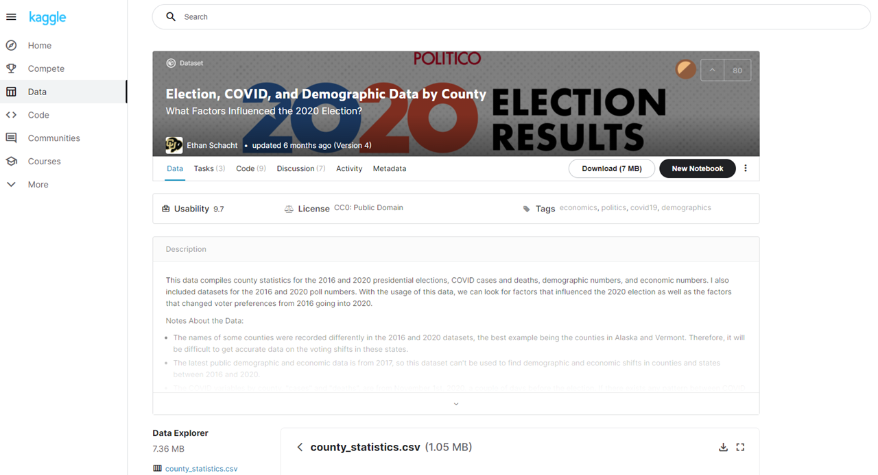
Our Data
Collected from Kaggle
“Election, COVID, and Demographic Data by County”
Variables include economic indicators (Income, Unemployment Rate, etc), race percentages (% White, % Black, etc), and many variables related to type of profession

Slide 10
Cleaning and Processing
Omitted rows with NAs
Removed COVID-related and transit-related fields
Created new columns for our outcome variables TrumpOrClinton & TrumpOrBiden, as well as a new column called RatioMenWomen

Slide 11
Methods Used
Regression Model- Predicting Trump % of Vote
Best Subset Selection
Forward Stepwise
Backward Stepwise
Linear Regression
Ridge Regression
Classification Model- Predicting County Winner
Logistic Regression
Linear Discriminant Analysis
Quadratic Discriminant Analysis
Support Vector Machines
Tree-Based Methods
Unpruned tree
Bagging
Random Forest

Slide 12
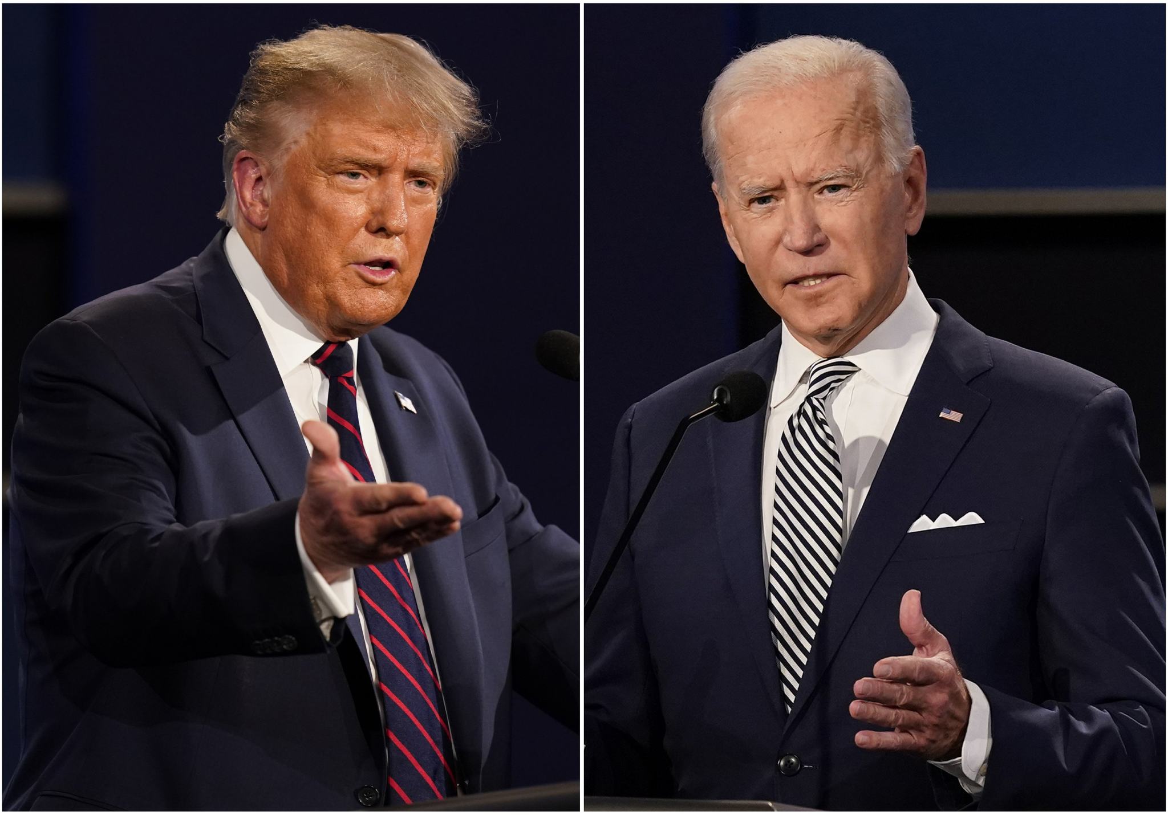
Results

Slide 13
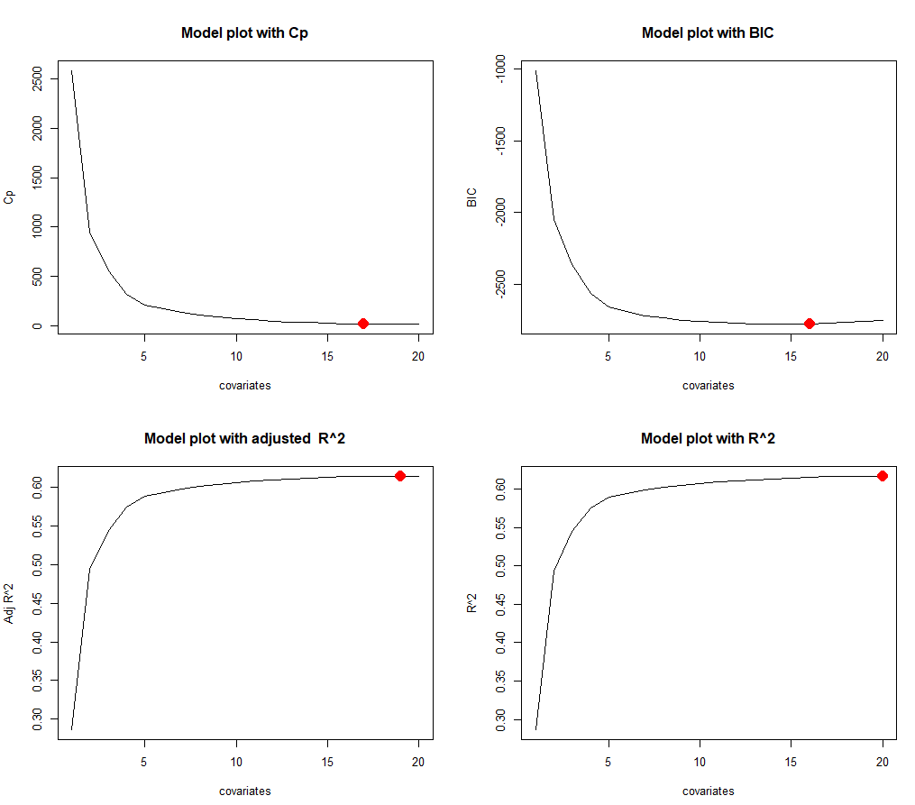
2016 Regression Model
Best Subset Selection

Slide 14
2016 Regression Model
Fit a Linear Regression Model
16 Variables with all 16 significant at the .05 level
Mean Squared Error = .00878

Slide 15
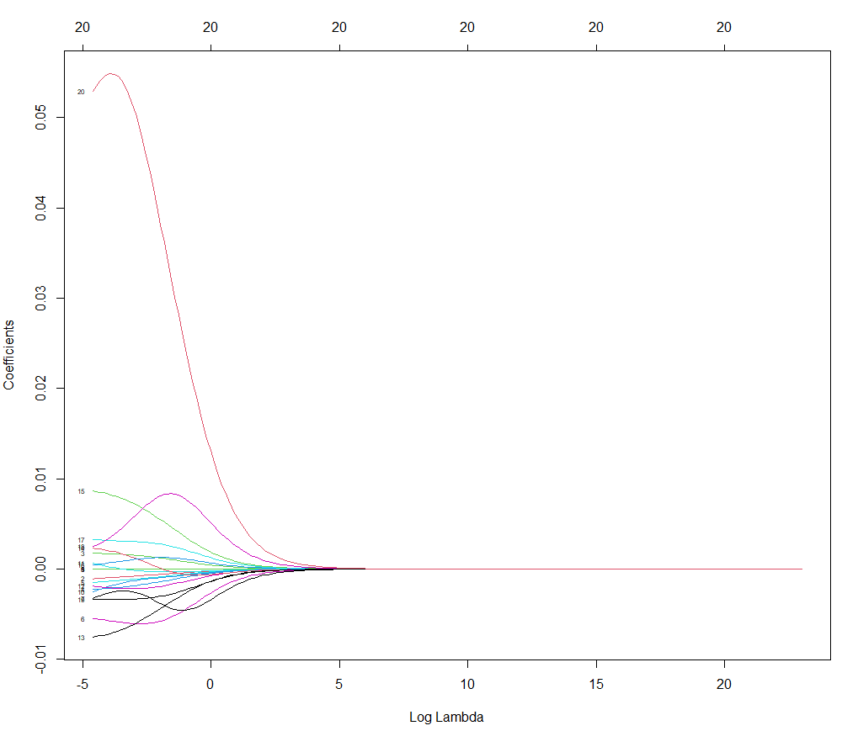
2016 Regression Model
Ridge Regression

Slide 16
2016 Regression Model
Comparing Methods
Method | Training Error-MSE | Testing Error-MSE
Linear Regression | 0.008984 | 0.008777
Ridge Regression | 0.009136 | 0.008776

Slide 17
2020 Regression Model
Same Procedure as 2016
Best Subset Selection recommended 16-18 variables
We fit a Linear Regression and compared the performance to Ridge Regression

Slide 18
2020 Regression Model
Comparing Methods
Method | Training Error-MSE | Testing Error-MSE
Linear Regression | 0.008473 | 0.007885
Ridge Regression | 0.008635 | 0.007890

Slide 19
2016 Classification Model
Logistic Regression Model using all 20 of our predictor variables
Only five significant at the .05 level: White, Income, IncomePerCapita, Poverty, ChildPoverty
Less variables might be preferred
Logistic Regression: 92.9% accurate

Slide 20
2016 Classification Model
Linear Discriminant Analysis: 93.4% accurate
Quadratic Discriminant Analysis: 92.8% accurate
Determined our decision boundary is more linear

Slide 21
2016 Classification Model
Support Vector Machines: 92.9% accurate
Linear kernel
Less interpretable
Computationally intensive (Tuning model took 3-4 minutes)

Slide 22
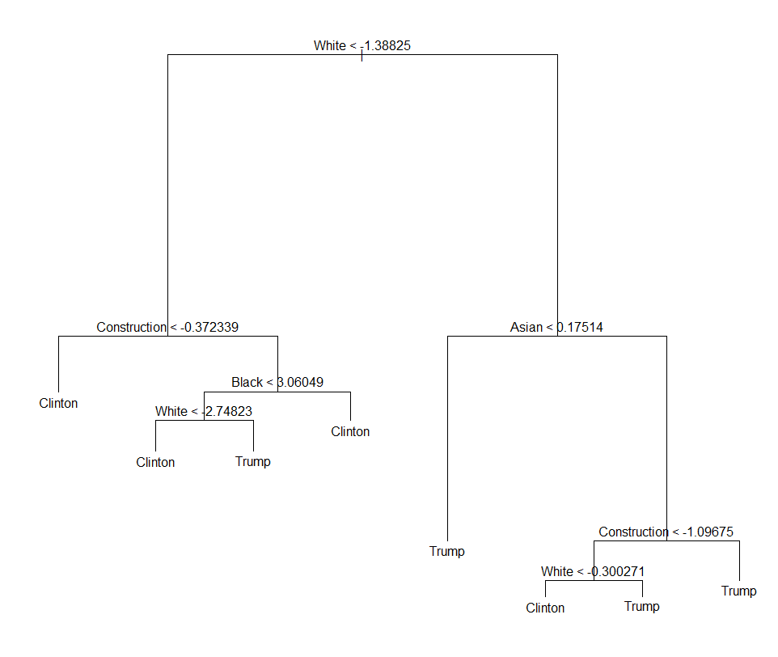
2016 Classification Model
Tree-Based Methods
Pruned decision tree: 11 terminal nodes, 92.2% accurate

Slide 23
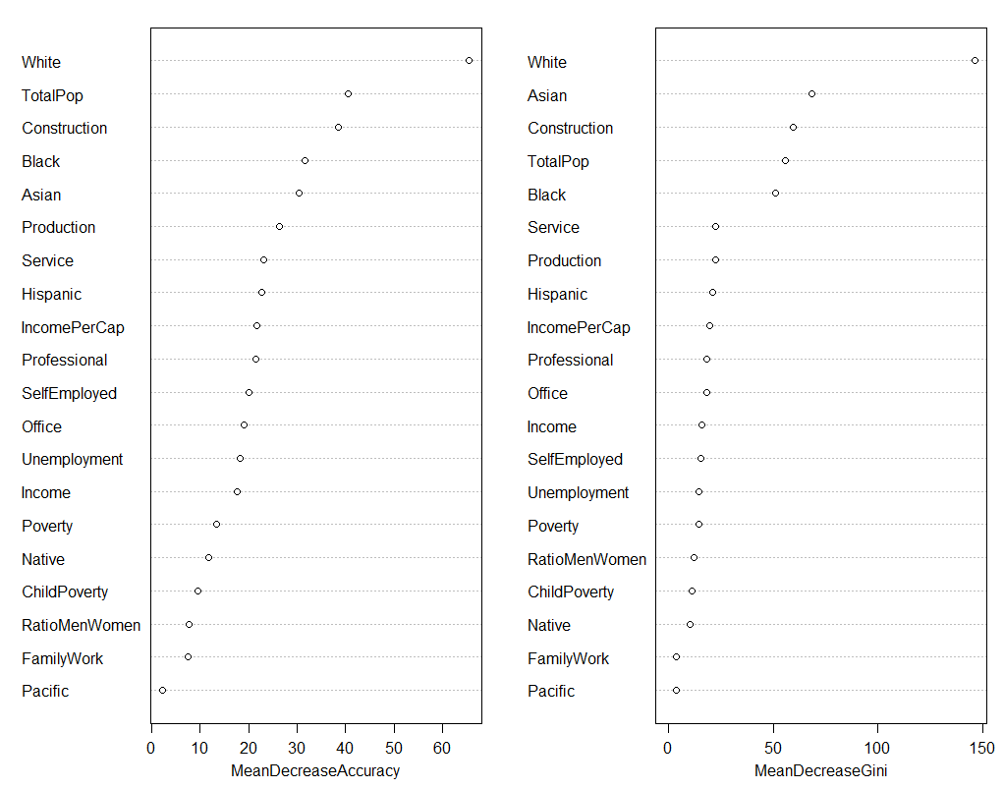
2016 Classification Model
Bagging: 94.9% accurate
Random Forest mtry=10: 95.1% accurate

Slide 24
2016 Classification Model
Comparing Methods
Method | Test Error- Misclassification Rate
Logistic Regression | 0.0706
Linear Discriminant Analysis | 0.0657
Quadratic Discriminant Analysis | 0.0723
Support Vector Machine | 0.0706
Random Forest | 0.0493

Slide 25
2020 Classification Model
Same Procedure as 2016 Model
First fit Logistic Regression, then compared LDA with QDA, tried Support Vector Machine tuned with linear kernel, then tried tree-based methods

Slide 26
2020 Classification Model
Comparing Methods
Method | Test Error- Misclassification Rate
Logistic Regression | 0.0887
Linear Discriminant Analysis | 0.0952
Quadratic Discriminant Analysis | 0.1215
Support Vector Machine | 0.0821
Random Forest | 0.0657

Slide 27

Discussion: What We Really Learned

Slide 28
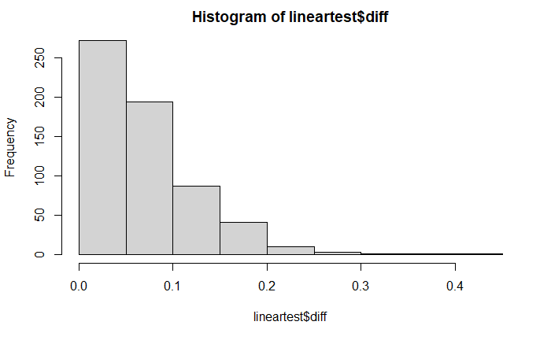
Interpreting Results
We developed a regression model with a MSE of only 0.007885. Roughly 470/610 within 10 percentage points of observed values

Slide 29
Interpreting Results
We developed a classification model that accurately predicts a county winner 95.1% of the time

Slide 30
Interpreting Results
With two election cycles, we can compare the changing significance and predictor power of demographic data.
For regression, compare 2016 and 2020 Ridge coefficients
For classification, compare 2016 and 2020 variable importance plots: Mean Decrease Accuracy & Mean Decrease Gini

Slide 31
Interpreting Results
Predictor | 2016 Election Model Coefficients | 2020 Election Model Coefficients
(Intercept) | 7.41E-01 | 7.92E-01
TotalPop | -1.97E-08 | -2.08E-08
Hispanic * | -1.12E-03 | -7.00E-04
White | 1.72E-03 | 1.76E-03
Black * | -2.31E-03 | -2.54E-03
Native | -1.57E-03 | -1.73E-03
Asian | -5.44E-03 | -5.50E-03
Pacific | -3.52E-03 | -1.36E-03
Income * | 1.10E-07 | 3.88E-08
IncomePerCap | -7.70E-06 | -8.63E-06
Poverty | -2.73E-03 | -2.37E-03
ChildPoverty | 7.39E-04 | 6.09E-04
Professional | -1.85E-03 | -2.22E-03
Service | -7.60E-03 | -7.64E-03
Office | 2.33E-03 | 1.47E-03
Construction * | 8.71E-03 | 9.12E-03
Production * | 4.06E-04 | 8.65E-04
SelfEmployed | 3.31E-03 | 3.64E-03
FamilyWork | 2.25E-03 | 2.11E-03
Unemployment | -3.37E-03 | -4.23E-03
RatioMenWomen | 5.19E-02 | 5.81E-02

Slide 32
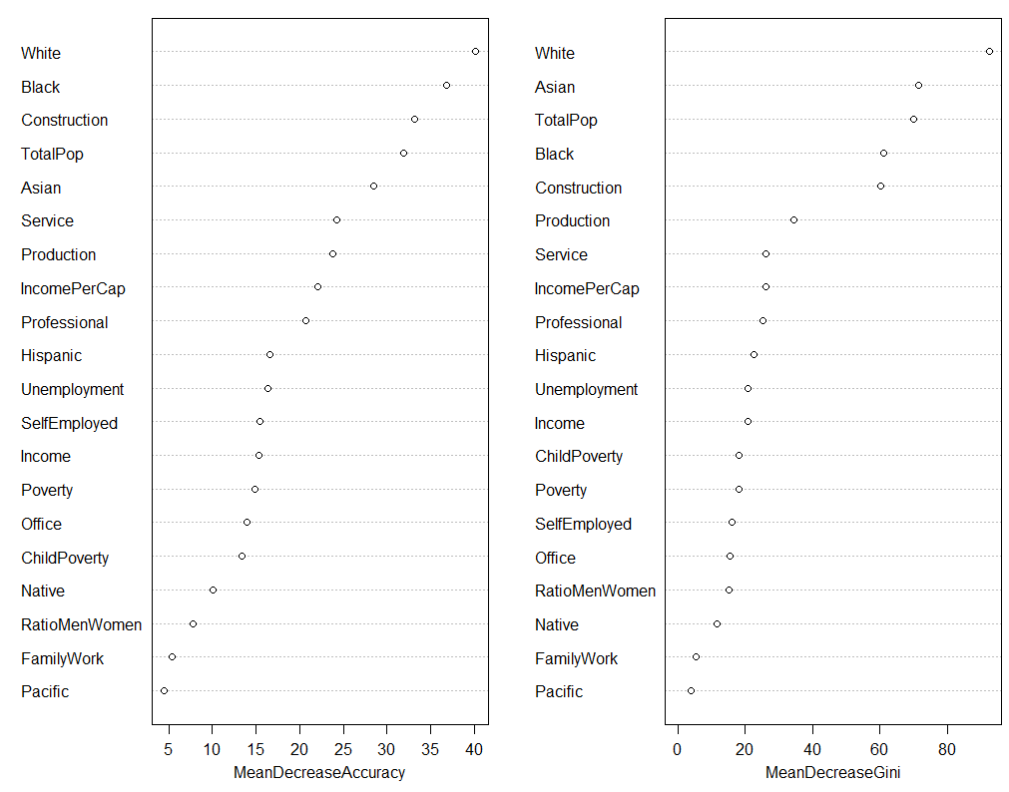
Interpreting Results
2016 Variable Importance
2020 Variable Importance

Slide 33
Limitations
Only two election cycles, so no way to tell if these ecological shifts are part of longer trends
No way to tell if shifts are because of changes in party, changes in candidate, both, or neither
Missing key demographic variables that could improve accuracy: Religion
Future research: Lagging mechanism to account for these longer demographic trends

Slide 34
Importance of Model
Examining demographic impact on future elections using yearly census data
Insights to county level demographic differences that could be helpful for campaigning/drawing congressional district boundaries
Real time precise predictions for election forecasts at county-level

Slide 35
References
Christopher, B. (2021, April 27). California loses congressional seat for first time: CalMatters California loses House seat. CalMatters. https://calmatters.org/politics/2021/04/california-congress-census/.
Hauck, G. (2021, May 1). Three states lose residents as U.S. sees slowest growth since the Great Depression, Census data&nbsp;shows. USA Today. https://www.usatoday.com/in-depth/news/nation/2021/05/01/illinois-mississippi-west-virginia-lost-residents-census-data-shows/4857864001/.
Lichtman, A. J.; Keilis-Borok, V. I. (1981, November). Pattern recognition applied to presidential elections in the United States, 1860-1980: Role of integral social, economic, and political traits. Proceedings of the National Academy of Sciences of the United States of America. https://www.ncbi.nlm.nih.gov/pmc/articles/PMC349231/.
Mitrani, A. (2019, September 27). Predicting Election Results With Census Data. Medium. https://medium.com/@amitrani/predicting-election-results-with-census-data-e70b772d981c.
Stoffa, J., Lisbona, R., Farrar, C., &amp; Martos, M. (n.d.). Predicting How U.S. Counties will Vote in Presidential Elections Through Analysis of Socio-Economic Factors, Voting Heuristics, and Party Platforms. SMU Scholar. https://scholar.smu.edu/datasciencereview/vol1/iss1/4/.

